Slide 1
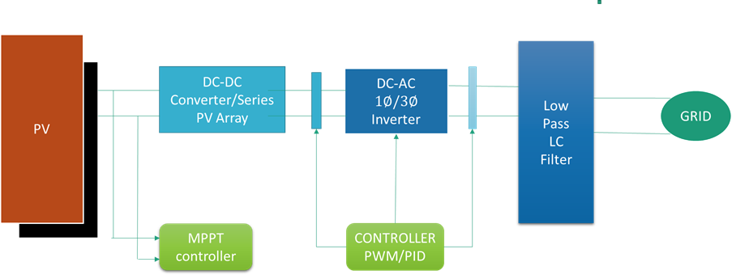
Introduction
PV converts sunlight into DC electricity
Inverters convert DC to AC for grid connection
Transformer-less inverters: compact, efficient, cost-effective
Challenge: Leakage current due to lack of galvanic isolation
Figure 1: Block diagram of a grid-connected PV system highlighting the inverter stage.

Slide 2
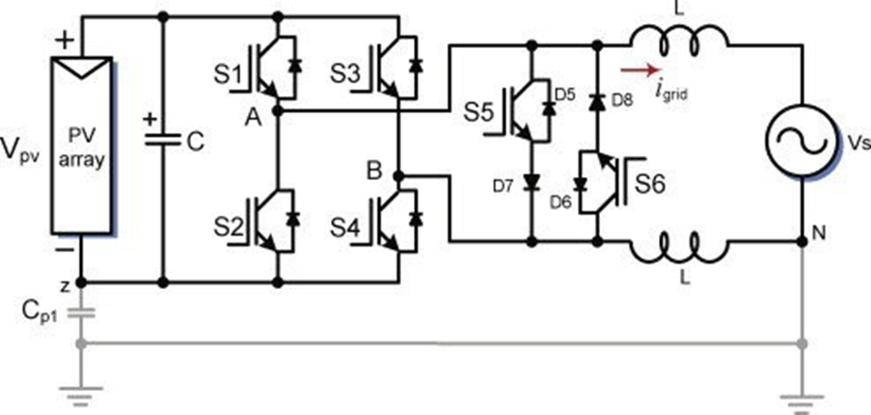
Transformerless Inverter in PV Systems
Traditional inverters: bulky & less efficient (with transformer)
Transformer-less inverters: smaller, lighter, higher efficiency
Widely used in modern grid-connected PV systems
Figure-2:Transformer-less inverter architechture (HERIC)

Slide 3
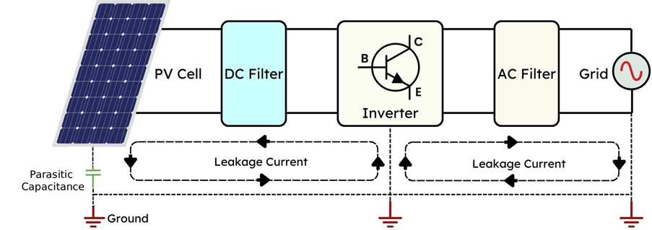
Leakage Current in PV Systems
Caused by parasitic capacitance between PV array & ground
Issues: EMI, reduced efficiency, safety concerns
Depends on topology, switching frequency, and modulation method
Figure 3: Leakage Current in PV Systems

Slide 4
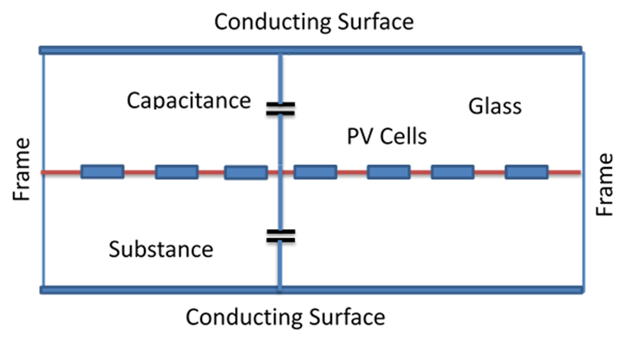
Parasitic Capacitance and Significance of Switching Frequency
Parasitic Capacitance:
Arises between PV panel and ground due to module structure and insulating layers
Directly affects leakage current magnitude and behavior
Figure 1.5: Parasitic capacitance in the PV cell.
High frequency → smaller filters, better power quality
But increases switching loss & thermal stress
Need optimal frequency range for balance between efficiency & leakage

Slide 5
Challenges and Limitations
Limited research in Bangladesh
Difficulty in MATLAB/Simscape simulation for leakage analysis
High-performance laptop/software needed (Overleaf, MATLAB)
Inconsistent research guidelines & lack of lab materials
Difficulty in power calculation for some topologies

Slide 6
Objectives of the Thesis
Investigate leakage current in transformerless inverter topologies
Study effect of switching frequency on leakage & efficiency
Determine optimal frequency range for better performance
Validate using simulation & analysis

Slide 7
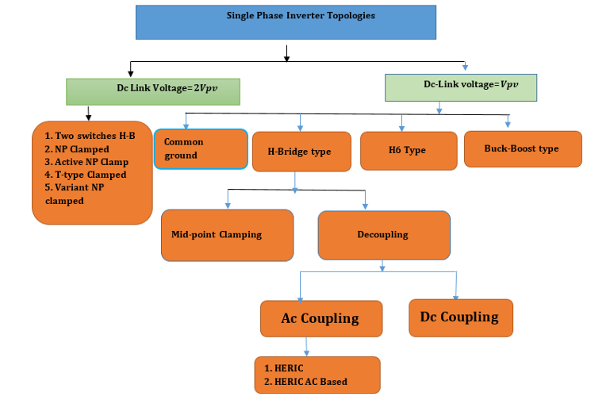
Classification of Topologies
We can discuss about only four topology in our thesis work
H4: Simple, high leakage
H5: Adds extra switch, reduces leakage
H6: Better isolation, lower conduction loss
HERIC: High efficiency, very low leakage

Slide 8
Comparison of Topologies
Comparison between different single-phase transformer-less inverter topologies present in this slide
H4 → High leakage, simple but less efficient
H5 → Lower leakage, moderate efficiency
H6 → Very low leakage, high efficiency
HERIC → Best balance, very high efficiency,

